Slide 1
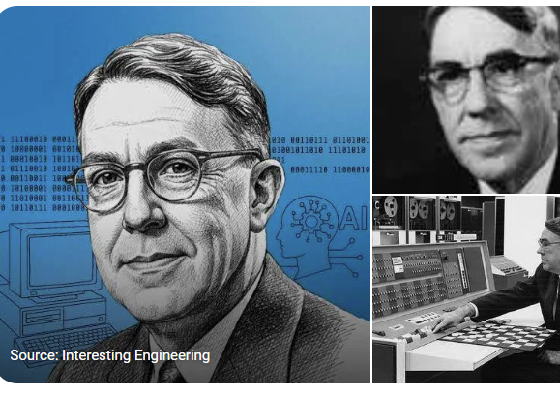
What is Machine Learning
ML is the science of computers so they can learn from data
Arthur Lee Samuel - Study that gives computers the ability to learn without being programmed
Arthur Lee Samuel (December 5, 1901 – July 29, 1990^{[3]}) was an American computer scientist and pioneer in the field of computer gaming and artificial intelligence.^{[2]} He coined the term machine learning in 1959.^{[4]}

Slide 2
Why use ML
Launch
Launch
Feed Data
Rules
“Subscribe”
“For U”
“Zero to Hero”
Evaluate
Train the Model
Evaluate
Study the problem
Study the problem
Analyze Errors
Analyze Errors
Traditional Programming Teacher gives exact instructions
Example Spam Detection using rules:
If email contains “WIN MONEY” → spam
If email has too many links → spam
Problems
Rules become very complex
Hard to maintain
Cannot handle changing patterns well
Student learns from examples and experience.
Example Instead of writing spam rules manually:
Give thousands of spam and non-spam emails
Model learns patterns automatically

Slide 3
Supervised Learning
1. Supervised Learning The model learns from labeled data (input + correct output).
Input → Correct Answer → Model learns pattern
Example
Email spam detection (spam / not spam)
House price prediction
Disease diagnosis
Goal
Predict output for new unseen data.
Common Algorithms
Linear Regression
Logistic Regression
Decision Trees
Support Vector Machines

Slide 4
Unsupervised Learning
Idea
The model learns from unlabeled data (no correct answers given).
Flow
Input data → Model finds patterns/groups
Example
Customer segmentation
Market basket analysis
Grouping similar news articles
Goal
Discover hidden patterns in data.
Common Algorithms
K-Means Clustering
Hierarchical Clustering
PCA (Dimensionality Reduction)

Slide 5
Reinforcement Learning
Idea
An agent learns by interacting with the environment and receiving rewards or penalties.
Flow
Action → Reward/Penalty → Learning → Better Action
Example
Game playing (chess, Go)
Robotics
Self-driving cars
Goal
Learn best actions to maximize reward.
Common Algorithms
Q-Learning
Deep Q Networks (DQN)

Slide 6
In Machine Learning, Batch Learning and Online Learning are two different ways a model learns from data.

Slide 7
Batch Learning (Offline learning)
Definition | System is incapable of learning incrementally and it must be trained using all available data Trained first and then launched into production Runs without learning any more)
Important Point | If you need to know about the new data then retrain from scratch on the full dataset and replace the old model with new one. Process of training, evaluation and launching is easy. How often you retrain depends on the use case- for e.g. cats and dogs model decays slowly as compared to making predictions on financial data
Advantage | Process of training, evaluation and launching is easy Solution is simple and often works fine but training using the full set of data can take many hours so you would typically train 24 hours or weekly
Challenges | Trained Offline - take lot of time, resources and money Model performance tends to decay slowly overtime since the world evolves while the model remains unchanged. Solution to it is to retrain the model Training on the full set of data requires lot of resources and money. If data is huge then even it is impossible to use Batch Learning
Which System Uses | Traditional Spam Filters Train once on a large email dataset Image Classification Models Example: training a cat vs dog classifier on a fixed dataset. The model is retrained only when enough new images are collected Recommendation Systems (older style) Some movie or product recommendation engines train nightly or weekly in batches Bank Loan Approval Models Banks often retrain models monthly or quarterly using historical customer data Fraud Detection Models (offline versions) Some systems analyze past transaction data in scheduled retraining cycles
Notes:
System is incapable of learning incrementally: must be trained using all available data
Trained Offline - take lot of time and resources
Trained first and then launched into production (Runs without learning any more)
Disadvantage – Model performance tends to decay slowly overtime since the world evolves while the model remains unchanged. Solution to it is to retrain the model
How often you retrain depends on the use case- for e.g. cats and dogs model decays slowly as compare to making predictions on financial data
If you need to know about the new data then retrain from scratch on the full dataset and replace the old model with new one. Process of training, evaluation and launching is easy.
Solution is simple and often works fine but training using the full set of data can take many hours so you would typically train 24 hours or weekly
Training on the full set of data requires lot of resources and money. If data is huge then even it is impossible to use Batch Learning

Slide 8
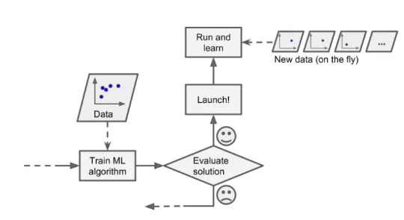
Online Learning
Definition | Train the system incrementally by feeding its data instance sequentially; in small batches Train models which requires huge data set that cannot fit on one machine (out-of-core-learning). Loads part of data runs a training step and repeat the process
Important Point | How fast ML systems adapts to changing data which is called learning rate High Learning Rate -> System adapt to new data -> Forgets old one Low Learning Rate -> System learn more slowly -> Less sensitive to new
Advantage | Fast and Cheap which would help to learn the system on the fly as data arrives
Challenges | If you inject bad data, then your system performance will decline and client can notice. Keep monitoring
Which System Uses | Stock Market Prediction Systems - Continuously update with new market prices Real-Time Fraud Detection Learns from newly detected fraudulent transactions immediately Recommendation Systems Platforms like YouTube or Netflix adapt recommendations based on recent user activity Ad Click Prediction Systems Google and social media platforms update models from live click behavior Self-Driving Cars Systems process continuous sensor data and adapt models over time

Slide 9
Instance Based Versus Model-Based Learning
It’s very important to understand how ML systems generalize
Good performance measure on training data is insufficient
Goal is how ML system predicts on new instances
There are two main approaches Instance Based Learning and Model Based Learning
Notes:
generalize

Slide 10
What is Generalization
The ability of a model to perform well on new, unseen data.
Simple Example
Suppose you train a model using pictures of cats.
During training:
It sees 1,000 cat images.
Later, you show it a completely new cat image.
If it still correctly says:
“This is a cat”
then the model has generalized well
Easy Student Analogy
Memorization
Student remembers exact answers only
Fails when question changes slightly.

Slide 11
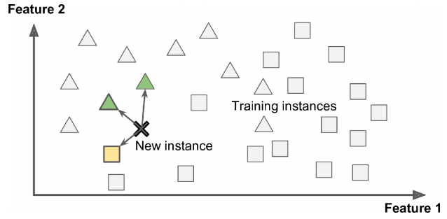
Instance Based Learning
System Learns By Heart then generalizes to new cases by using a similarity measure to compare to the learned example
Spam Filter application can used Instance base learning to flag emails that are identical to known spam emails.
This requires a “Measure of similarity” – system counts the no. of words they have in common and flag an email as spam if they have many words in common
New instance would be classified as a triangle because similar instances belongs to that class

Slide 12
Model Based Learning
Another way to generalize from a set of examples is to build a model and use that model to make predications
Steps to generalize using model
Collect data
Choose a model
Train the model
Use it to make predictions

Slide 13
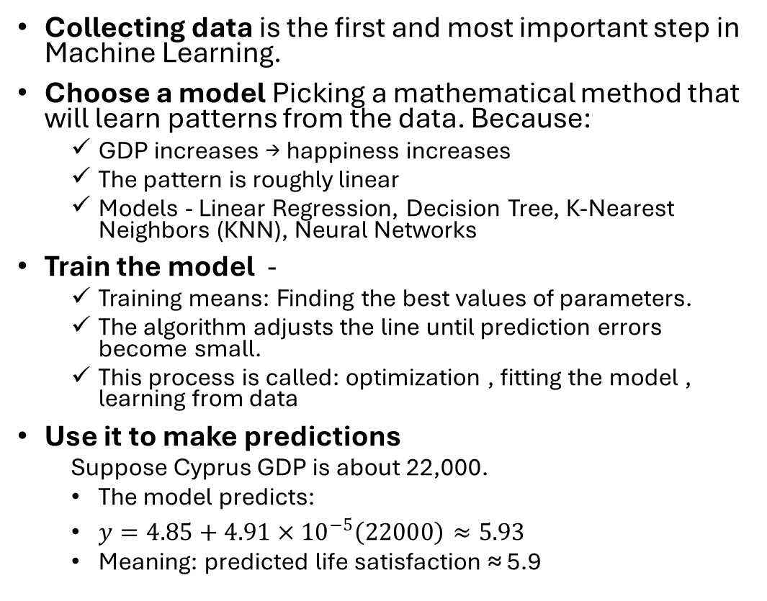
Does money make people happier?
Collecting data is the first and most important step in Machine Learning.
Choose a model Picking a mathematical method that will learn patterns from the data. Because:
GDP increases → happiness increases
The pattern is roughly linear
Models - Linear Regression, Decision Tree, K-Nearest Neighbors (KNN), Neural Networks
Train the model -
Training means: Finding the best values of parameters.
The algorithm adjusts the line until prediction errors become small.
This process is called: optimization , fitting the model , learning from data
Use it to make predictions
Suppose Cyprus GDP is about 22,000.
The model predicts:
$y=4.85+4.91×{10}^{−5}\left(22000\right)≈5.93$
Meaning: predicted life satisfaction ≈ 5.9
Country | GDP per capita (X) | Life Satisfaction (Y)
India | 2000 | 4.5
France | 42000 | 6.8
USA | 60000 | 7.2

